Slide 1

Forecasting Monthly Weather Using Deep Learning: A Spatial-Temporal Comparison
Zhenlong Zhang

Slide 2

Project Objectives
Goal: Evaluate whether deep learning models improve the accuracy and spatial interpretability of monthly weather forecasting compared to traditional methods.
Objectives:
Forecasting Accuracy (Temporal Dimension)
Compare LSTM and ARIMA using monthly weather data from individual stations.
Hypothesis: LSTM will outperform ARIMA in predictive accuracy due to its ability to model nonlinear temporal patterns.
Spatial Interpretability (Spatial Dimension)
Compare LSTM and CNN-LSTM across multiple spatially distributed stations.
Use Moran’s I on hidden states to assess spatial structure in learned representations.
Hypothesis: CNN-LSTM will better capture spatial dependencies than standard LSTM.
Notes:
In the project, I had two main objectives, each focusing on a different potential strength of deep learning models.
First, I wanted to evaluate whether LSTM can produce more accurate monthly weather predictions than traditional ARIMA models.
which ARIMA is just a linear model and often fails to capture nonlinear and long-term temporal patterns.
Second, beyond accuracy, I wanted to evaluate whether deep learning models can also help improve the spatial interpretability of the weather data.
Unlike ARIMA, which can only work with one station at a time and has no notion of space, deep learning models like ConvLSTM are able to incorporate spatial structure through convolution over the grid of stations.
Here, I’m not comparing ARIMA and CNN-LSTM, because ARIMA cannot model spatial relationships at all.
Instead, I compare CNN--LSTM with LSTM, to see whether adding spatial structure leads to more accuracy and more spatially coherent hidden representations.
To measure this, I use Moran’s I, a classic measure of spatial autocorrelation, applied to the hidden states learned by both models.
So overall, the project is not just about improving prediction accuracy, but also about exploring whether deep learning can reveal underlying spatial patterns in the data.

Slide 3
Dataset and Preprocessing
Data Source
NOAA Global Historical Climatology Network – Daily (GHCN-D)
Time range: 2010–2024
Location: Maryland
Variables: AVG, TMAX, TMIN, PRECIP
Station Coverage
752 total stations in Maryland
473 stations with valid records
Aggregated to monthly level → 47 stations retained
Only 14 stations had full monthly coverage but use binary mask to use the whole 47 stations for model input
Notes:
For this project, I used publicly available weather data covering the state of Maryland from 2010 to 2024.
The dataset includes four variables that I gonna use : average temperature, minimum temperature, maximum temperature, and precipitation.
I started with 752 weather stations across Maryland. After converting the daily data to the monthly level, I ended up with 47 stations.
Out of these, only 14 stations had full coverage for the time period.
However, to keep as much spatial information as possible, I used abinary mask for model input.

Slide 4
Models Explanation
AutoRegressive Integrated Moving Average (ARIMA)
Traditional linear time series model
Trained separately for each weather variable
Cannot model nonlinear patterns or spatial relationships
Long Short-Term Memory (LSTM)
A type of recurrent neural network (RNN) for sequential data
Captures nonlinear and long-term temporal dependencies
Inputs: past 12 months of 4 variables (AVG, TMAX, TMIN, PRECIP)
Convolutional Long Short-Term Memory (CNN-LSTM)
Extension of LSTM that integrates spatial structure
Applies convolution over a 2D station grid at each time step
Learns both spatial and temporal dependencies
Requires spatial alignment of stations and binary masking for missing data
Notes:
For the three models I use in this project. The first one is ARIMA autoregressive integrated moving average. The second one is Long Short-Term Memory recurrent neural network. The last one is a convolutional LSTM, by incorporating CNN, it enables to model spatial structure

Slide 5
How LSTM works
Designed to model sequential and time-dependent data
A special type of Recurrent Neural Network (RNN)
Maintains a cell state (memory) that flows through time
Can remember long-term patterns and ignore noise
Uses three gates to control information flow:
Input Gate – decides what new information to store
Output Gate – determines the output at each time step
Forget Gate – filters out irrelevant past information
Notes:
Let me explain the key difference between a traditional ANN and an LSTM.
Traditional ANNs are simple feedforward networks that treat each input independently.
But when we deal with data with time series, ANNs cant capture the pattern
In this case, LSTM is used for data with time seriess. They include a memory cell that is updated over time through gates.
The forgetting gate decides what information to ignore, the input gate controls what new information to be added, and the output gate determines what to pass on.
This structure enables LSTMs to learn from both short- and long-term patterns

Slide 6
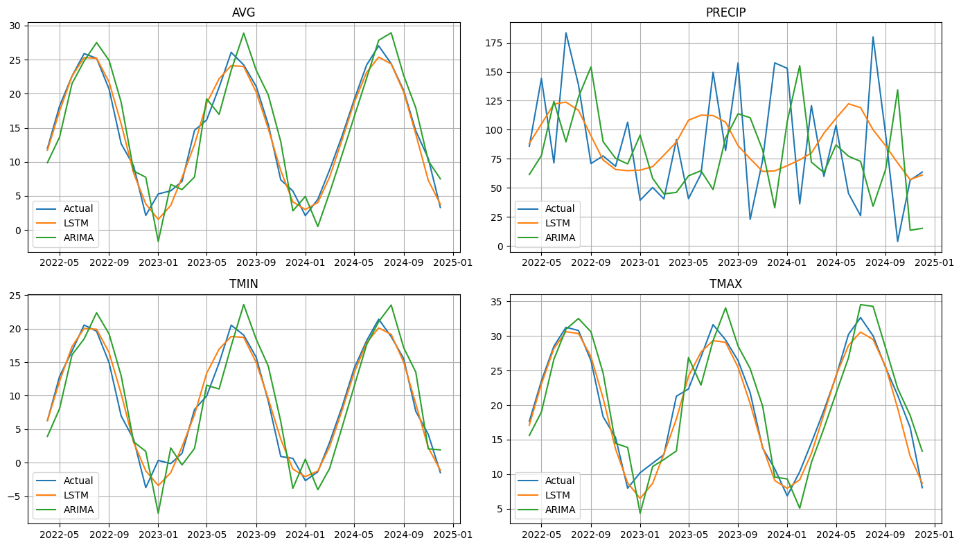
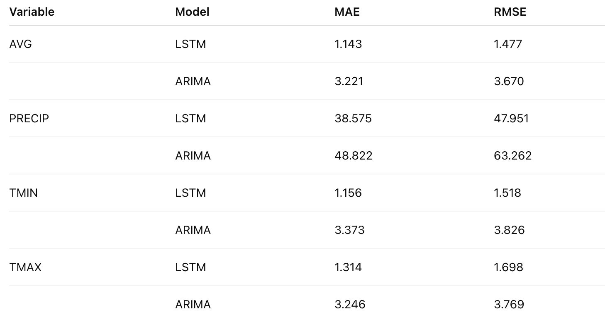
Compare LSTM to ARIMA
Notes:
To evaluate predictive accuracy, I compared LSTM and the traditional model on a single weather station for visulazation. The first 80 percent is used for training and the remining is used for testing.
I used two standard evaluation metrics:
Mean Absolute Error (MAE) and Root Mean Squared Error (RMSE).
As the results show, LSTM significantly outperforms across all four variables.
For example, the RMSE for average temperature with LSTM is around 1.4, whereas traditional model’s RMSE is over 3—which is a huge difference
however for precipitation, I dont think either one works well due the noice. Although ARIMA 's loss is higher, it appears to make an effort to follow short-term patterns. where, the LSTM feels like it is just finding a overall central tendency, rather than capturing the actual underlying pattern.
The graph on the left shows the model predictions on the test set.
You can see that for the most part LSTM closely follows the actual values

Slide 7
LSTM vs CNN-LSTM – Spatial Analysis
Both models trained on 47 stations using monthly weather data
Focus: whether CNN-LSTM learns better spatial structure than LSTM?
Moran’s I and Permutation test used to evaluate spatial autocorrelation in hidden states
Result:
- LSTM Moran’s I: mean = –0.0209, std = 0.0403
- CNN-LSTM Moran’s I: mean = –0.0163, std = 0.0539
- Permutation test: p = 0.1595 → not significant
Notes:
The graph on the bottom left is showing the change in hidden state. the stations are graphed by their acutual locations. and darker the point is meaning the higher correlation there is.
So, I compared the hidden state representations learned by LSTM and CNN-LSTM across 47 spatially distributed stations.
To evauate whether CNN-LSTM captures spatial patterns better, I used Moran’s I, which is a measure of spatial autocorrelation.
The results showed that CNN-LSTM had a slightly higher average Moran’s I than LSTM, but the difference was not statistically significant. The p-value from a permutation test was 0.1595, which means we can't conclude that CNN-LSTM captured spatial structure more effectively.
So even though CNN-LSTM is designed to model spatial relationships, in this case, data limitations may have caused this nonsignicant p-value.

